Slide 1
Cse 316
Computer
Security
Principles

Slide 2

We have a working Full-Stack Web application
But that’s just a start
Now the hard part
Turn an app into a product
takes a focus on the product
Products care about the user when providing services
remember our Principles of High Quality Software

Slide 3

We need our Web application to be secure
Why?
to protect our:
assets
customers
data
reputation
Someone might
steal our stuff
use our stuff
break our stuff
test how to steal/use/break our or others’ stuff

Slide 4


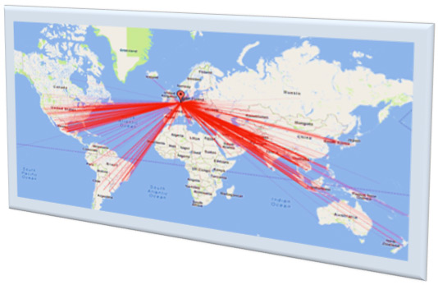
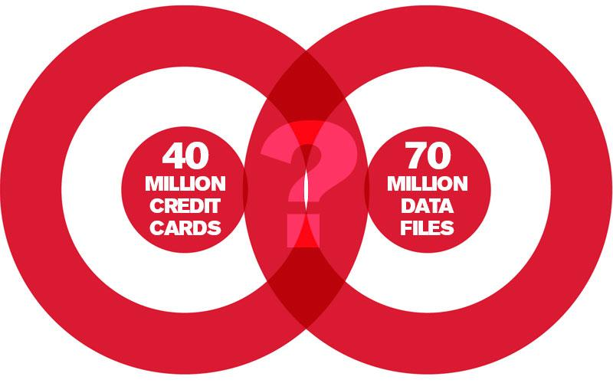
High Profile Cyberattacks

Slide 5
Asset Clarification
1st things 1st
Identify and classify data the application will handle
Choose security restrictions that suit the data. Ex:
medical records
financial records
personal information

Slide 6
Understanding Attackers
Programmers should design controls that prevent misuse of the application by different types of malicious parties, including (from most to least dangerous):
Disgruntled staff members and programmers
Drive-by attacks that release viruses or Trojan attacks onto the system
Motivated cybercriminals
Criminal organizations with malicious intent
Script kiddies
The most dangerous type of attacks that developers must safeguard against are from disgruntled staff members and programmers.
may have a high level of access to sensitive systems
Programmers can use OWASP principles techniques to safeguard against these types of attacks

Slide 7
Security Requirements
Confidentiality
anonymity
unlinkability
Integrity
Availability

Slide 8
Big Picture Ways to get there
Threat models
helps enumerate potential problems
helps design & build secure systems
Trust assumptions
helps with abstraction layers
Risk analysis
spend time/money/resources properly

Slide 9
Security Design Principles
Least Privilege
Fail-Safe Defaults
Economy of Mechanism
Complete Mediation
Open Design
Separation of Privilege
Least Common Mechanism
Psychological Acceptability

Slide 10
Least Privilege
Applied to abstraction layers
Layer entities can only access what they need
Keep them on a need to know basis
Apply to user accounts

Slide 11
Fail-Safe Defaults
By default don’t provide access
Permission has to be explicitly granted
Err on the side of caution

Slide 12
Economy of Mechanism
Make security mechanisms simple
Simpler systems are better understood
Lower chance of errors or vulnerabilities

Slide 13

Complete Mediation
Always check access rights for every use

Slide 14
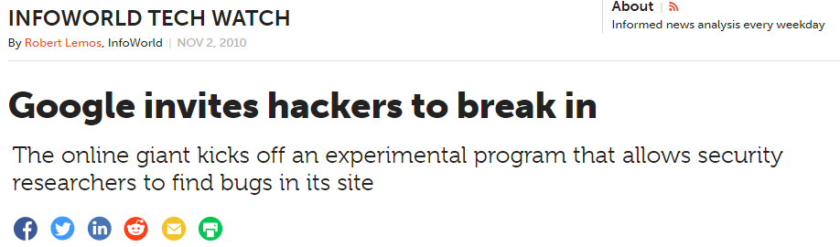
Open Design
An entity’s security should not depend on the secrecy of its design
Encryption algorithms are well known
Some organizations invite hackers to try

Slide 15
Separation of Privilege
Separate users and processes based on levels of:
trust
needs
privilege requirements
Segmentation of user privileges
Compartmentalization of privileges

Slide 16

Least Common Mechanism
Mechanisms used to access resources should not be shared
Do not give out your Netflix account info!

Slide 17

Psychological Acceptability
Security mechanisms should not make a resource more difficult to access than if the mechanisms were not present

Slide 18
What tools do we have?
Firewalls
Accounts/Login Systems
Cryptography
And many other things
APIs and tools are key

Slide 19
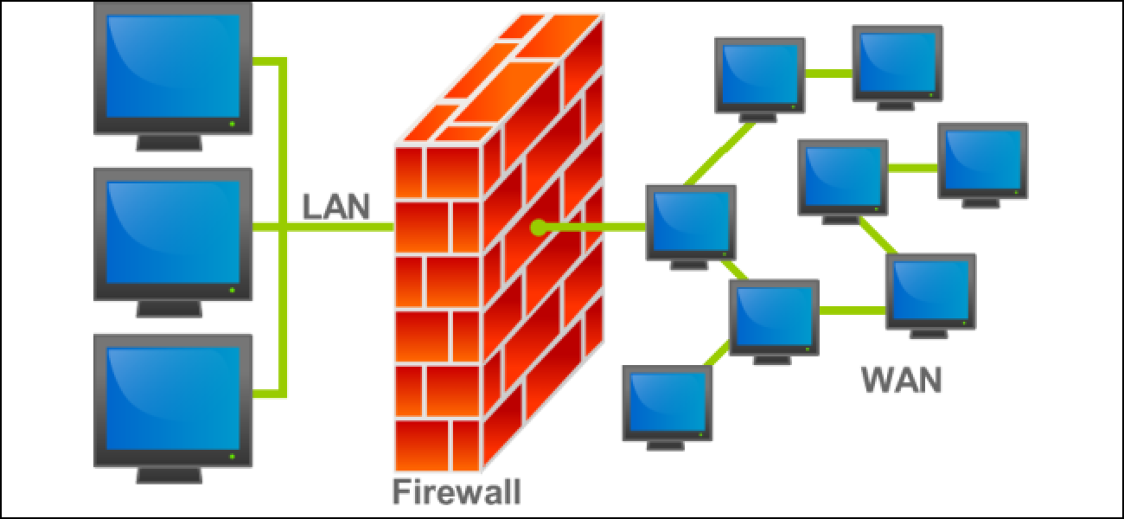
Firewall
Network Security System
Monitors all traffic
Can close access to specific IP Addresses & Ports

Slide 20
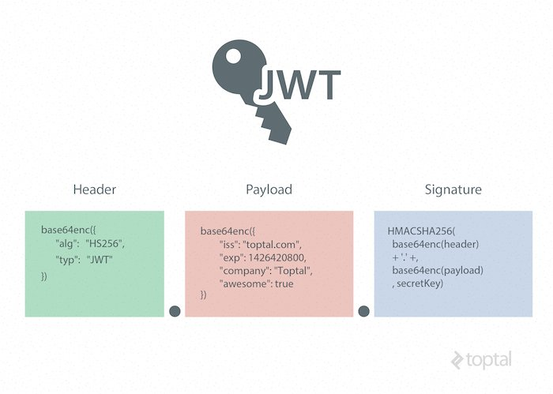
Accounts/Login System
Credentials can be stored in Web Tokens

Slide 21
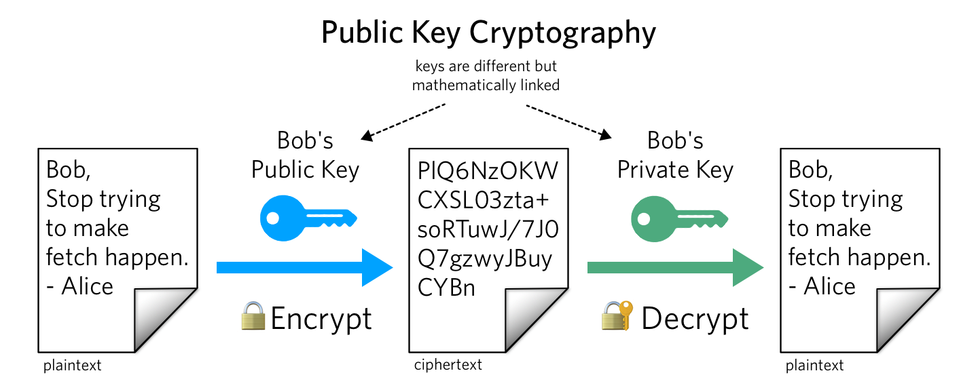
Cryptography
Plaintext → Ciphertext
encryption
Ciphertext → Plaintext
decryption
How does public key encryption work?

Slide 22
public key encryption (like RSA)
Two parties wish to communicate
Each party generates two keys
one private to keep (for decryption)
one public to share (for encryption)
Amazon generates a key pair
Amazon gives me the public key
Amazon keeps the private key
To send a message to Amazon, I encrypt it using that public key
Only Amazon has the private key, so only Amazon can decrypt the message

Slide 23
8 Principles of Web Security
Authentication (confirm user identity)
Authorization (specify access rights to resources)
Confidentiality (message encryption)
Data Integrity (data cannot be changed without detection)
Message Integrity (messages cannot be changed without detection)
Availability (no DNoS)
Accountability (actions should be traceable)
Non-repudiation (must be able to prove a transaction took place)

Slide 24
Next Time
Types of attacks to be wary of
Real MERN mechanisms to protect our site

Slide 25
References
Security by Design Principles according to OWASP
https://blog.threatpress.com/security-design-principles-owasp/
8 Principles of Web Security
https://arch.simplicable.com/arch/new/the-8-principles-of-web-security

